Slide 1
Web Technologies
UNIT I JAVA FUNDAMENTALS

Slide 2
History of Java
1991 – Birth of the Idea
Project Green: Java began as a project by James Gosling, Mike Sheridan, and Patrick Naughton at Sun Microsystems.
Originally designed for embedded systems and appliances (like set-top boxes).
The language was initially called Oak, named after an oak tree outside Gosling's office.
1995 – Official Launch as Java
Oak was renamed to Java (Oak was already a trademark).
Sun Microsystems officially launched Java in May 1995.
Released with the slogan: "Write Once, Run Anywhere" (WORA) — thanks to the Java Virtual Machine (JVM).

Slide 3
History of Java
Key Features Introduced
Platform independence using the JVM.
Object-oriented design.
Robust memory management (automatic garbage collection).
Network-centric programming.
1996–1999 – Early Growth
Java Development Kit (JDK) 1.0 and 1.1 released.
Quickly gained popularity for web applets and server-side applications.
Launch of Java 2 (J2SE, J2EE, J2ME):
J2SE – Standard Edition
J2EE – Enterprise Edition
J2ME – Micro Edition (for mobile and embedded)

Slide 4
History of Java
2000s – Enterprise Domination
Java became dominant in enterprise applications (banking, web apps).
Introduction of Java Server Pages (JSP) and Servlets.
Tools like Eclipse, NetBeans, and Spring Framework emerged.
2006 – Java Goes Open Source
Sun open-sourced Java by releasing it under the GNU General Public License (GPL).
Launch of the OpenJDK project.

Slide 5
History of Java
2010 – Oracle Acquires Sun Microsystems
Oracle Corporation took over Java’s development.
Major versions began to roll out more consistently.
Introduction of JavaFX for GUI applications.
2014–2017 – Major Language Enhancements
Java 8 introduced:
Lambdas and functional interfaces
Streams API
Default methods in interfaces
Java 9 (2017): Introduced modular programming with the Java Platform Module System (JPMS).

Slide 6
History of Java
2018 – New Release Cadence
Oracle adopted a 6-month release cycle:
New features added more frequently.
LTS (Long-Term Support) every 3 years (e.g., Java 8, 11, 17, 21).
Recent Versions (2021–2025)
Java 17 (2021) – LTS version with performance and syntax improvements.
Java 21 (2023) – Latest LTS with features like record patterns, virtual threads (Project Loom).
Continued emphasis on performance, modern syntax, and cloud readiness.

Slide 7
Applications
Powers billions of devices and apps.
Widely used in:
Enterprise software (banking, insurance)
Android app development
Scientific computing
Cloud and big data platforms (Hadoop, Spark)

Slide 8
Introduction to Java
Java one of the world’s most widely used computer programming language.
Enterprise programming
Implement Internet based applications
Java Standard Edition
Java Enterprise Edition
Java Micro Edition
Java derives much of its character from C & C++
Syntax of C
echoing object oriented features of C++
Java- Programmer’s Language

Slide 9
Introduction to Java
Features of Java (Java Buzzwords)
The primary objective of Java programming language creation was to make it portable, simple and secure programming language.
Simple
Java is very easy to learn, and its syntax is simple, clean and easy to understand.
Object-oriented
Java is an object-oriented programming language. Everything in Java is an object.
Platform Independent
Java is platform independent
Java is platform independent because it is different from other languages like C, C++, etc. which are compiled into platform specific machines while Java is a write once, run anywhere language.
A platform is the hardware or software environment in which a program runs.
Java provides a software-based platform.
The Java platform differs from most other platforms in the sense that it is a software-based platform that runs on top of other hardware-based platforms. It has two components:
Runtime Environment
API(Application Programming Interface)
Secured
Java is secured because:
No explicit pointer
Java Programs run inside a virtual machine sandbox

Slide 10
Java's security model is renowned for its robust and comprehensive features, designed to protect applications from various threats. Here's a breakdown of the key components:
1. Bytecode Verification:
Prevention of Malicious Code: Java's compiler generates bytecode, which is a platform-independent intermediate representation of the code. Before execution, the Java Virtual Machine (JVM) performs rigorous bytecode verification to ensure that the code adheres to Java's syntax, semantics, and type safety rules. This prevents malicious code from executing and compromising the system.
2. Sandboxing:
Isolation of Applications: Java's sandboxing mechanism isolates applications from each other and the underlying operating system. Each application runs in its own sandbox, limiting its access to resources and preventing it from interfering with other applications or the system. This helps to contain the impact of any security breaches.
3. Security Manager:
Fine-grained Control: The Security Manager is a configurable component of the JVM that allows you to define security policies and control the permissions granted to applications. You can specify which actions applications can perform, such as file I/O, network access, and system properties. This provides granular control over the security of your applications.
4. Class Loader:
Controlled Loading: The class loader is responsible for loading classes into the JVM. It follows a hierarchical structure, ensuring that classes are loaded from trusted sources. This prevents unauthorized code from being loaded and executed.

Slide 11
5. Garbage Collection:
Memory Management: Java's automatic garbage collection system helps prevent memory-related vulnerabilities like buffer overflows. By automatically managing memory allocation and deallocation, it reduces the risk of errors that could be exploited by attackers.
6. Security APIs
Cryptographic Operations: Java provides a rich set of APIs for cryptographic operations, including encryption, decryption, digital signatures, and hashing. These APIs allow developers to implement strong security measures to protect sensitive data.
7. Security Best Practices:
Coding Guidelines: Java encourages developers to follow secure coding practices to minimize vulnerabilities. This includes avoiding common security pitfalls like SQL injection, cross-site scripting (XSS), and cross-site request forgery (CSRF).
8. Regular Updates:
Patching Vulnerabilities: Oracle, the primary developer of Java, regularly releases updates to address security vulnerabilities. It's essential to keep your Java installations up-to-date to benefit from the latest security patches.

Slide 12
Introduction to Java
Portable
Java is portable because it facilitates you to carry the Java bytecode to any platform. It doesn't require any implementation.
High-performance
Java is faster than other traditional interpreted programming languages because Java bytecode is "close" to native code.
It is still a little bit slower than a compiled language (e.g., C++).
Distributed
Java is distributed because it facilitates users to create distributed applications in Java.
RMI and EJB are used for creating distributed applications.
Multi-threaded
A thread is like a separate program, executing concurrently.
Advantage of multi-threading is that it doesn't occupy memory for each thread. It shares a common memory area.

Slide 13
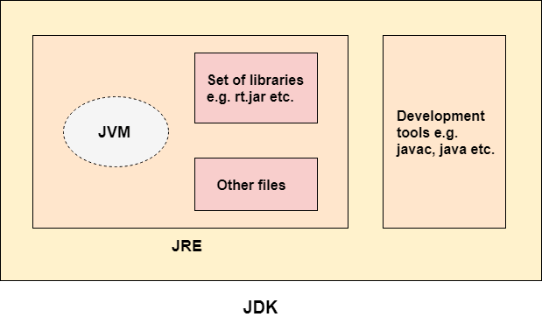
Introduction to Java
JRE
JRE is an acronym for Java Runtime Environment.
It is also written as Java RTE. The Java Runtime Environment is a set of software tools which are used for developing Java applications.
It is used to provide the runtime environment. It is the implementation of JVM. It physically exists. It contains a set of libraries + other files that JVM uses at runtime.
JDK
JDK is an acronym for Java Development Kit.
The Java Development Kit (JDK) is a software development environment which is used to develop Java applications and applets. It physically exists. It contains JRE + development tools.
The JDK contains a private Java Virtual Machine (JVM) and a few other resources such as an interpreter/loader (java), a compiler (javac), an archiver (jar), a documentation generator (Javadoc), etc. to complete the development of a Java Application.
The JVM executes Java bytecode and includes:
Interpreter – executes bytecode line-by-line
JIT Compiler (Just-In-Time) – compiles frequently used bytecode into native machine code for faster execution

Slide 14
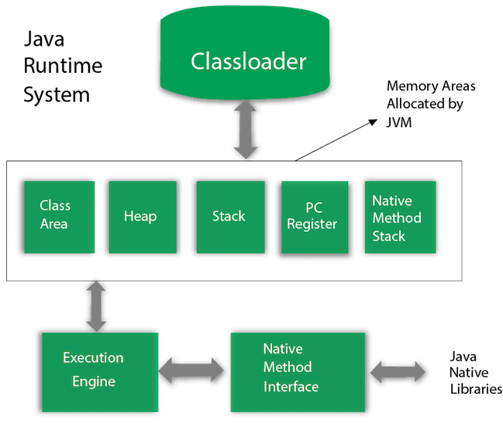
Introduction to Java
JVM(Java Virtual Machine) is an abstract machine.
It is called a virtual machine because it doesn't physically exist.
It is a specification that provides a runtime environment in which Java bytecode can be executed.
It can also run those programs which are written in other languages and compiled to Java bytecode.
JVMs are available for many hardware and software platforms.
JVM, JRE, and JDK are platform dependent because the configuration of each OS is different from each other. (platform independent).
There are three notions of the JVM: specification, implementation, and instance.
The JVM performs the following main tasks:
Loads code
Verifies code
Executes code
Provides runtime environment

Slide 15
Introduction to Java
Object-Oriented Programming is a methodology or paradigm to design a program using classes and objects.
Object
Any entity that has state and behavior is known as an object.
An Object can be defined as an instance of a class. An object contains an address and takes up some space in memory.
Objects can communicate without knowing the details of each other's data or code.
Class
It is a logical entity.
A class can also be defined as a blueprint from which you can create an individual object. Class doesn't consume any space.
Inheritance
When one object acquires all the properties and behaviors of a parent object, it is known as inheritance. It provides code reusability.
Polymorphism
If one task is performed in different ways, it is known as polymorphism.

Slide 16
Introduction to Java
Abstraction
Hiding internal details and showing functionality is known as abstraction.
In Java, we use abstract class and interface to achieve abstraction.
Encapsulation
Binding (or wrapping) code and data together into a single unit are known as encapsulation.

Slide 17
Introduction to Java
class Simple{
public static void main(String args[]){
System.out.println("Welcome to web technology class"); }
}
To compile: javac Simple.java
To execute: java Simple
Java code(Simple.java)→compiler→Simple.class
class keyword is used to declare a class in Java.
public keyword is an access modifier that represents visibility. It means it is visible to all.
static is a keyword. If we declare any method as static, it is known as the static method. The core advantage of the static method is that there is no need to create an object to invoke the static method. The main() method is executed by the JVM, so it doesn't require creating an object to invoke the main() method. So, it saves memory.
void is the return type of the method. It means it doesn't return any value.
main represents the starting point of the program.
String[] args or String args[] is used for command line argument.Collection of variables in string format.
System.out.println() is used to print statement. Here, System is a class(in package java.lang), out is an object of the PrintStream class(java.io.printstream) and static member of system class, println() is a method of the PrintStream class(java.io.printstream)

Slide 18
Introduction to Java
import java.util.*;
public class addition{
public static void main(String []args){
Scanner i1= new Scanner(System.in);
int n1;
int n2;
int sum;
System.out.println("Enter first integer");
n1=i1.nextInt();
System.out.println("Enter two integer");
n2=i1.nextInt();
sum=n1+n2;
System.out.println("Sum is"+sum);
}}
Scanner class in java.util package
new keyword to create a scanner object that reads keystrokes from keyboard.
System.in→ enables applications to read bytes of info typed by the user.
nextInt()- To input an integer typed by the user @keyboard
next(), nextLine(), nextInt(), nextDouble()

Slide 19
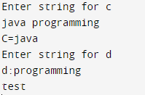
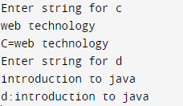
Introduction to Java
import java.util.*;
public class addition{
public static void main(String []args){
Scanner i1= new Scanner(System.in);
System.out.println("Enter string for c");
String c=i1.next();
System.out.println("C="+c);
System.out.println("Enter string for d");
String d=i1.next();
System.out.println("d:"+d);
}}
next()- To read input only till space
It cant read two words separated by space.
Places the cursor in the same line after reading the input.
nextLine()- reads input including space between words (that is read till newline)
Once the input is read, Positions the cursor in next line

Slide 20
Introduction to Java-Variables
In Java, you can get input in several ways depending on the source of input (keyboard, file, GUI, network, etc.).
Source | Method/Class Used
Console (basic) | Scanner, BufferedReader, Console
File input | BufferedReader, FileReader, Scanner
GUI input | JOptionPane (Swing)
Command-line args | String[] args
Network input | Socket, BufferedReader, InputStream

Slide 21
1. Scanner Class (Most Common)
Package: java.util
Introduced in Java 5
Reads different types of data easily.
import java.util.Scanner;
public class InputDemo {
public static void main(String[] args) {
Scanner sc = new Scanner(System.in);
System.out.print("Enter your name: ");
String name = sc.nextLine();
System.out.print("Enter your age: ");
int age = sc.nextInt();
System.out.println("Name: " + name);
System.out.println("Age: " + age);
sc.close(); }}

Slide 22
2. BufferedReader Class
Package: java.io
Reads text efficiently.
Input is read as a String and converted to other types manually.
import java.io.BufferedReader;
import java.io.InputStreamReader;
import java.io.IOException;
public class InputDemo {
public static void main(String[] args) throws IOException {
BufferedReader br =
new BufferedReader(new InputStreamReader(System.in));
System.out.print("Enter your name: ");
String name = br.readLine();
System.out.print("Enter your age: ");
int age = Integer.parseInt(br.readLine());
System.out.println("Name: " + name);
System.out.println("Age: " + age);
}}
Advantages
Faster than Scanner
Suitable for large input

Slide 23
3. Console Class
Package: java.io
Reads input from the console.
Can hide password input.
import java.io.Console;
public class InputDemo {
public static void main(String[] args) {
Console con = System.console();
String name = con.readLine("Enter Name: ");
char[] password = con.readPassword("Enter Password: ");
System.out.println("Welcome " + name);
}
}
Advantages
Password is hidden
Good for command-line applications
Disadvantages
Does not work in many IDEs (e.g., Eclipse, IntelliJ, VS Code)

Slide 24
Introduction to Java-Variables
Java Variables
A variable is a container which holds the value while the Java program is executed.
A variable is assigned with a data type.
Variable is a name of memory location.
There are three types of variables in java:
local, instance and static.
There are two types of data types in Java: primitive and non-primitive.
Local Variable
A variable declared inside the body of the method is called local variable.
Variable can be used only within that method and the other methods in the class aren't even aware that the variable exists.
A local variable cannot be defined with "static" keyword. Eg. void test(){int a=10;}
Instance Variable
A variable declared inside the class but outside the body of the method, is called an instance variable.
It is not declared as static.
It is called an instance variable because its value is instance-specific and is not shared among instances. class c{int a=10;}
Static variable
A static variable in Java belongs to the class itself rather than to any specific instance of the class.
This means there's only one copy of the variable in memory, shared by all objects of the class
Any change to the static variable affects all instances. Eg. static int a=10;
Accessed using the class name: ClassName.count;

Slide 25
Introduction to Java-Variables
Local Variable
Scope: Within a method or block.
Lifetime: Exists only while the method or block is executing.
Use cases:
Temporary storage for calculations or intermediate results.
Storing values that are specific to a method's execution.
Avoiding unnecessary object creation.
public void calculateArea(int length, int width) {
int area = length * width; // Local variable to store the calculated area
System.out.println("Area: " + area);
}
Instance Variables
Scope: Within a class, but outside of any method.
Lifetime: Exists as long as the object exists.
Use cases:
Storing data specific to each object instance.
Representing object properties or attributes.
Maintaining state information between method calls.
class Person {
String name; // Instance variable to store the person's name
int age; // Instance variable to store the person's age
}

Slide 26
Introduction to Java-Variables
Static Variables
Scope: Within a class, but outside of any method.
Lifetime: Exists as long as the class is loaded.
Use cases:
Storing data that is shared by all instances of a class.
Creating constants (using the final keyword).
Keeping track of global counters or statistics.
class Counter {
static int count = 0; // Static variable to count the number of objects created
}

Slide 27
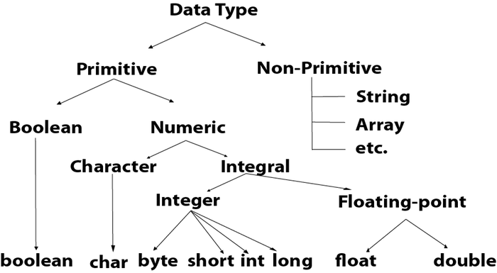
Introduction to Java
Data Type | Default Value | Default size
boolean | false | 1 bit
char | '\u0000' | 2 byte
byte | 0 | 1 byte
short | 0 | 2 byte
int | 0 | 4 byte
long | 0L | 8 byte
float | 0.0f | 4 byte
double | 0.0d | 8 byte
Datatypes

Slide 28
Operators in Java
Operator in Java is a symbol that is used to perform operations. For example: +, -, *, / etc.
Unary Operator:
The Java unary operators require only one operand. Unary operators are used to perform various operations i.e.:
incrementing/decrementing a value by one, negating an expression, inverting the value of a Boolean
Arithmetic Operator:
Arithmetic operators are used to perform addition, subtraction, multiplication, and division.
Shift Operator:
The Java left shift operator << is used to shift all of the bits in a value to the left side of a specified number of times.
Right shift operator >> is used to move the value of the left operand to right by the number of bits specified by the right operand.
Relational Operator:
comparison:<, > ,<= ,>=, instanceof and equality: ==, !=
Bitwise Operator: bitwise & operator always checks both conditions whether first condition is true or false
bitwise | operator always checks both conditions whether first condition is true or false.
Logical Operator: The logical && operator doesn't check the second condition if the first condition is false. It checks the second condition only if the first one is true.
The logical || operator doesn't check the second condition if the first condition is true. It checks the second condition only if the first one is false.
Ternary Operator: Ternary operator is used as one line replacement for if-then-else statement
only conditional operator which takes three operands.
Assignment Operator: = += -= *= /= %= etc., Used to assign the value on its right to the operand on its left.

Slide 29
Introduction to Java
Keywords
Java keywords are also known as reserved words.
Keywords are particular words that act as a key to a code.
These are predefined words by Java so they cannot be used as a variable or object name or class name.
abstract, boolean, break, byte, case, catch, char, class, continue, default, do, double, else, extends, final, finally, implements, new, null, synchronized etc.,
Java provides three types of control flow statements.
Decision Making statements: if statements,switch statement Loop statements:do while loop,while loop,for loop, for-each loop Jump statements: break statement, continue statement
Decision Making statements: Decision-making statements evaluate the Boolean expression and control the program flow depending upon the result of the condition provided.
Simple if statement:
if(condition) {
statement 1;
}
Nested if:
if(condition 1) {
statement 1;
if(condition 2) {
statement 2;
}
else{
statement 3;
} }
If-else statement:
if(condition) {
statement 1;
}
else{
statement 2;
}
If-else-if statement:
if(condtn1) {
statement 1; }
else if(condtn2) {
statement 2;
}
else {
statement 3; }

Slide 30
Introduction to Java
Switch Statement:
similar to if-else-if statements.
The switch statement contains multiple blocks of code called cases and a single case is executed based on the variable which is being switched.
case variables can be int, short, byte, char, String or enumeration.
Cases cannot be duplicate
Default statement is executed when any of the case doesn't match the value of expression. It is optional.
Break statement terminates the switch block when the condition is satisfied. It is optional, if not used, next case is executed.
switch (expression){
case value1:
statement1;
break;
.
.
case valueN:
statementN;
break;
default:
default statement;
}

Slide 31
Introduction to Java
Loop Statements
Loop statements are used to execute the set of instructions in a repeated order. The execution of the set of instructions depends upon a particular condition.
There are three types of loops that execute similarly. However, there are differences in their syntax and condition checking time.
for loop, while loop, do-while loop
for loop:
for(initialization, condition, increment/decrement) {
//block of statements
}
For-each:
for(data_type var : array_name/collection_name){
//statements }
int[] numbers = {1, 2, 3, 4, 5};
for (int number : numbers) { System.out.println(number); }
when:You don’t need the index
You’re not modifying the original data
You just want to read or process each element
while loop: (Entry controlled Loop)
while(condition){
//looping statements
}
do-while loop(Exit Controlled Loop):
do
{
//statements
} while (condition);
Jump statements:
break: break statement used to break the current flow of the program and transfer the control to the next statement outside a loop or switch statement.
continue statement: doesn't break the loop, whereas, it skips the specific part of the loop and jumps to the next iteration of the loop immediately.

Slide 32
Introduction to Java-Class and Object
multiple classes are allowed in different Java files or single Java file. If multiple classes is defined in a single Java source file, it is a good idea to save the file name with the class name which has main() method.
class Student{
int id;
String name;
}
class TestStudent{
public static void main(String args[]){
Student s1=new Student();
System.out.println(s1.id);
System.out.println(s1.name);
}
}
Assigning values directly using object.var
Quick manual initialization
Initialize objects: By reference variable, By method, By constructor
Initialization through reference- Initializing an object through reference means storing data into the object.
multiple objects can be created and it can store information in it through reference variable.
class Student{
int id;
String name;
}
class TestStudent3{
public static void main(String args[]){
//Creating objects
Student s1=new Student();
Student s2=new Student();
//Initializing objects
s1.id=101;
s1.name=“abc";
s2.id=102;
s2.name=“pqr";
//Printing data
System.out.println(s1.id+" "+s1.name);
System.out.println(s2.id+" "+s2.name);
}
}

Slide 33
Introduction to Java-Class and Object
Initialization through method
Eg: creating the two objects of Student class and initializing the value to these objects by invoking the insertRecord method.
Also displaying the state (data) of the objects by invoking the displayInformation() method.
class Student{
int rollno;
String name;
void insertRecord(int r, String n){
rollno=r;
name=n;
}
void displayInformation(){System.out.println(rollno+“ "+name);} }
class TestStudent{
public static void main(String args[]){
Student s1=new Student();
Student s2=new Student();
s1.insertRecord(111,“abc");
s2.insertRecord(222,“pqr");
s1.displayInformation();
s2.displayInformation(); } }
object gets the memory in heap memory area.
The reference variable refers to the object allocated in the heap memory area.
Here, s1 and s2 both are reference variables that refer to the objects allocated in memory.
Use setter/custom method after creation
When input comes dynamically
Rollno=111
Name=abc
s2
Rollno=222
Name=pqr
s1
Heap memory
Stack memory

Slide 34
Introduction to Java-Class and Object
Initialization through constructor
Object is initialized automatically at the time of creation using a constructor.
class Student{
int rollno;
String name;
Student(int r, String n){
rollno=r;
name=n;
}
void displayInformation(){System.out.println(rollno+“ "+name);} }
class TestStudent{
public static void main(String args[]){
Student s1=new Student(111,”abc”);
Student s2=new Student(222,”pqr”);
s1.displayInformation();
s2.displayInformation(); } }
Initialize at object creation
Clean & safe initialization pattern

Slide 35
Java-Arrays
Arrays
Collection of similar type of elements which has contiguous memory location.
All arrays are dynamically allocated
Since arrays are objects in Java, we can find their length using the object property length.
This is different from C/C++ where we find length using sizeof.
A Java array variable can also be declared like other variables with [] after the data type.
The variables in the array are ordered and each have an index beginning from 0.
Java array can be also be used as a static field, a local variable or a method parameter.
The size of an array must be specified by an int or short value and not long.
Java provides the feature of anonymous arrays which is not available in C/C++
Advantages
Code Optimization: It makes the code optimized, we can retrieve or sort the data efficiently.
Random access: We can get any data located at an index position.
Disadvantages
Size Limit: We can store only the fixed size of elements in the array. It doesn't grow its size at runtime. To solve this problem, collection framework is used in Java which grows automatically.
instanceof operator
Used to test whether the object is an instance of the specified type (class or subclass or interface).
Also known as type comparison operator because it compares the instance with type.
It returns either true or false.
If instanceof operator is applied with any variable that has null value, it returns false.
public class test{
public static void main(String args[]){
test s=new test();
System.out.println(s instanceof test);
test s1=null;
System.out.println(s1 instanceof test);
} }

Slide 36
Java-Arrays
Types of Arrays
Two types of array.
Single Dimensional Array
Multidimensional Array
Declaring Array Variables
Declare a variable to reference the array, and you must specify the type of array the variable can reference.
Syntax for declaring an array variable −
dataType[] arrayRefVar;
or
dataType arrayRefVar[];
or
dataType []arrayRefVar;
Instantiation of an Array in Java
arrayRefVar=new datatype[size];
Declaring an array variable, creating an array, and assigning the reference of the array
dataType[] arrayRefVar = new dataType[arraySize]; or dataType[] arrayRefVar = {value0, value1, ..., valuek};

Slide 37
Java-Arrays
Anonymous Array in Java
Java supports the feature of an anonymous array : Don’t need to declare the array while passing an array to the method.
For Anonymous array creation, do not mention size in []. The number of values passing inside {} will become the size.
An anonymous array in Java is an array that is created and used without assigning it to a variable. It's often used for one-time use cases, typically when passing an array as a parameter to a method.
When to Use Anonymous Arrays:
When you need to create an array for immediate use and don't need to reference it later.
When passing an array as an argument to a method.
class TestAnonymousArray{
//creating a method which receives an array as a parameter
void printArray(int arr[]){
for(int i=0;i<arr.length;i++)
System.out.println(arr[i]);
} }
public class test{
public static void main(String args[]){
TestAnonymousArray t1= new TestAnonymousArray();
t1.printArray(new int[]{10,22,44,66});//passing anonymous array to method
}}
public class Testarray{
public static void main(String args[]){
int a[]=new int[5];//declaration and instantiation
a[0]=10;//initialization
a[1]=20;
a[2]=70;
a[3]=40;
a[4]=50;
for(int i=0;i<a.length;i++)//length is the property of array
System.out.println(a[i]);
double b[]={33.1,3.4,4.80,5.565};
double total=0.0;
for(int i=0;i<b.length;i++)//length is the property of array
{
System.out.println(b[i]);
total += b[i];
}
System.out.println("total "+total);
int arr[]={33,3,4,5};
System.out.println("eg for foreach");
for(int i:arr)
System.out.println(i);
}}

Slide 38
Java-Arrays
Returning Array from the Method
Method returning the array must have the return type as an array of the same data type as that of the array being returned.
class TestReturnArray{
//creating method which returns an array
int[] get(){
return new int[]{10,30,50,90,60};
}
}
public class test{
public static void main(String args[]){
TestReturnArray t1= new TestReturnArray();
//calling method which returns an array
int arr[]=t1.get();
//printing the values of an array
for(int i=0;i<arr.length;i++)
System.out.println(arr[i]);
}}
Passing an array to method
class Testarray2{
void min(int arr[]){
int min=arr[0];
for(int i=1;i<arr.length;i++)
if(min>arr[i])
min=arr[i];
System.out.println(min);
}}
public class test{
public static void main(String args[]){
Testarray2 t= new Testarray2();
int a[]={33,3,4,5};
t.min(a);//passing array to method
}}

Slide 39

Java-Arrays
Multidimensional Array : Data is stored in row and column based index
Declaring Array Variables
Syntax for declaring an array variable −
dataType[][] arrayRefVar; (or)
dataType [][]arrayRefVar; (or)
dataType arrayRefVar[][]; (or)
dataType []arrayRefVar[];
Instantiation of an Array in Java
arrayRefVar=new datatype[size][];
Eg.int[][] arr=new int[3][3];
Eg to Initialize the values
arr[0][0]=1;
arr[0][1]=2;
arr[0][2]=3;
arr[1][0]=4;
arr[1][1]=5;
arr[1][2]=6;
arr[2][0]=7;
arr[2][1]=8;
arr[2][2]=9;
public class Testarray3{
public static void main(String args[]){
//declaring and initializing 2D array
int arr[][]={{1,2,3},{2,4,5},{4,4,5}};
//printing 2D array
for(int i=0;i<3;i++){
for(int j=0;j<3;j++){
System.out.print(arr[i][j]+" ");
}
System.out.println();
}
}}

Slide 40


Java-Arrays
Copying a Java Array:copy an array to another by the arraycopy() method of System class.
Syntax of arraycopy method
public static void arraycopy( Object src, int srcPos,Object dest, int destPos, int length)
public class TestArrayCopyDemo {
public static void main(String[] args) {
//declaring a source array
char[] copyFrom = { 'h', 'i', 'i', 't', 'd', 'e', 'p',
't', '.', 'a', 't', 'e', 'd' };
//declaring a destination array
char[] copyTo = new char[7];
//copying array using System.arraycopy() method
System.arraycopy(copyFrom, 2, copyTo, 0, 7);
//printing the destination array
System.out.println(String.valueOf(copyTo));
}
}
Jagged Array in Java
Jagged array: It is an array of arrays with different number of columns.
public class TestJaggedArray{
public static void main(String[] args){
//declaring a 2D array with odd columns
int arr[][] = new int[3][];
arr[0] = new int[3];
arr[1] = new int[5];
arr[2] = new int[2];
//initializing a jagged array
int count = 0;
for (int i=0; i<arr.length; i++)
for(int j=0; j<arr[i].length; j++)
arr[i][j] = count++;
//printing the data of a jagged array
for (int i=0; i<arr.length; i++){
for (int j=0; j<arr[i].length; j++){
System.out.print(arr[i][j]+" ");
}
System.out.println();//new line
} } }

Slide 41
Java-Arrays
Arrays Class
The java.util.Arrays class contains various static methods for sorting and searching arrays, comparing arrays, and filling array elements.
public static int binarySearch(Object[] a, Object key)
The array must be sorted prior to making this call. This returns index of the search key, if it is contained in the list; otherwise, it returns ( – (insertion point + 1)).
public static boolean equals(long[] a, long[] a2)
Returns true if the two specified arrays of longs are equal to one another. Two arrays are considered equal if both arrays contain the same number of elements.
public static void fill(int[] a, int val)
Assigns the specified int value to each element of the specified array of int.
public static void sort(Object[] a)
Sorts the specified array of objects into an ascending order, according to the natural ordering of its elements.

Slide 42
Java-Methods
A method is a block of code or collection of statements or a set of code grouped together to perform a certain task or operation.
It provides the reusability of code.
It is also provides the easy modification and readability of code, just by adding or removing a chunk of code.
main() is the starting point for JVM to start execution of a Java program. Without the main() method, JVM will not execute the program.
Method Declaration
The method declaration provides information about method attributes, such as visibility, return-type, name, and arguments.
Syntax
Access_specifier returntype methodname (parameter list)
{
//method body;
}
Methodname(parameter list)→ method signature
Access_specifier: public, private, protected, Default
Return_type: data type that the method returns.
Method_name: unique name based on the functionality,
parameter list: parameters separated by comma in ().It includes datatype and variable name
Method body: Enclosed within { }. It includes actions to be performed.
Types of Method:
Predefined method-Defined in Java Class libraries
Standard library method or built-in method. Eg. sqrt(), print()
User-defined method
Instance method
Static method
Abstract method
Factory method

Slide 43
Java-Methods
A method is a block of code or collection of statements or a set of code grouped together to perform a certain task or operation.
It provides the reusability of code.
It is also provides the easy modification and readability of code, just by adding or removing a chunk of code.
main() is the starting point for JVM to start execution of a Java program. Without the main() method, JVM will not execute the program.
Private
Least accessible.
Members (variables, methods) are accessible only within the same class.
Not accessible from outside the class or even in subclasses.
Public
Most accessible.
Members are accessible from anywhere
Same class
Other classes
Subclasses
Different packages
Protected
Accessible within the same package, and also in subclasses
(even if in different packages).
Commonly used for inheritance.
Use private for fields to encapsulate data.
Use public for methods that form the public API.
Use protected when designing inheritance hierarchies.
Modifier | Same Class | Same Package | Subclass (different package) | Other Classes
private | ✅ | ❌ | ❌ | ❌
(default) | ✅ | ✅ | ❌ | ❌
protected | ✅ | ✅ | ✅ | ❌
public | ✅ | ✅ | ✅ | ✅

Slide 44
Java-Constructors
Named as constructor because it constructs the values @ time of object creation
It is not necessary to write a constructor for a class, because java compiler creates a default constructor if your class doesn't have any.
It has a block of codes similar to the method. It is called when an instance of the class is created.
When constructor is called, memory for the object is allocated.
It is a special type of method which is used to initialize the object.
Every time an object is created using the new() keyword, at least one constructor is called.
if there is no constructor available in the class., Java compiler provides a default constructor by default.
Implicit return type of a class constructor is the class type itself.
Rules for creating Java constructor
Constructor name must be the same as its class name
no explicit return type
constructor cannot be abstract, static, final, and synchronized
Two types of constructors in Java: no-arg constructor, and parameterized constructor.
Default Constructor:
A constructor is called "Default Constructor" when it doesn't have any parameter.
Syntax of default constructor:
<class_name>(){}
If there is no constructor in a class, compiler automatically creates a default constructor.
Default constructor is used to provide the default values to the object like 0, null, etc.,
depending on the type.
public class mit{
//creating a default constructor
mit()
{
System.out.println("MIT is created");
}
//main method
public static void main(String args[])
{
//calling a default constructor
mit b=new mit();
}
}

Slide 45
Java-Constructors
Parameterized Constructor
A constructor which has a specific number of parameters is called a parameterized constructor.
Usage: To provide different/Same values to distinct objects.
public class Student{
int id;
String name;
//creating a parameterized constructor
Student(int i,String n){
id = i;
name = n;
}
//method to display the values
void display(){System.out.println(id+" "+name);}
public static void main(String args[]){
//creating objects and passing values
Student s1 = new Student(111,"abc");
Student s2 = new Student(222,"pqr");
//calling method to display the values of object
s1.display();
s2.display();
}
}

Slide 46

Java-Constructors
By Constructor:
public class Student{
int id;
String name;
//constructor to initialize integer and string
Student(int i,String n){
id = i;
name = n;
}
//constructor to initialize another object
Student(Student s){
id = s.id;
name =s.name;
}
void display(){System.out.println(id+" "+name);}
public static void main(String args[]){
Student s1 = new Student(111,"ABC");
Student s2 = new Student(s1);
s1.display();
s2.display();
}
}
Copy Constructor
Java does not have a built-in copy constructor like C++ does, but the concept of copying an object can still be implemented manually
There is no copy constructor in Java.
we can copy the values from one object to another like copy constructor in C++.
copy the values of one object into another following ways are used:
By constructor
By assigning the values of one object into another
By clone() method of Object class

Slide 47
Java-Constructors
Task of Constructor:
Initialization
object creation, starting a thread, calling a method, etc. can perform any operation in the constructor as performed in the method.
Copy Constructor
By assigning the values of one object into another:
copy the values of one object into another by assigning the objects values to another object.
public class Student{
int id;
String name;
Student(int i,String n){
id = i;
name = n;
}
Student(){}
void display(){System.out.println(id+" "+name);}
public static void main(String args[]){
Student s1 = new Student(111,"ABC");
Student s2 = new Student();
s2.id=s1.id;
s2.name=s1.name;
s1.display();
s2.display();
}
}

Slide 48
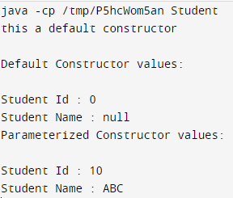
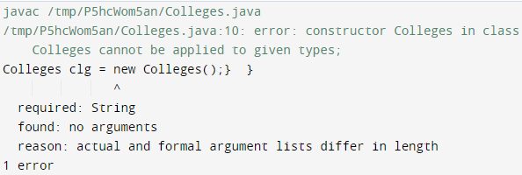

Java-Constructors
Purpose of constructor overloading:
When we need to use multiple constructors to initialize the different values of the class.
Java compiler invokes a default constructor when we do not use any constructor in the class.
However, the default constructor is not invoked if we have used any constructor in the class, whether it is default or parameterized.
Java compiler throws an exception saying the constructor is undefined.
public class Colleges {
String collegeId;
Colleges(String cid){
cid = "MIT " + collegeId;
}
public static void main(String[] args) {
Colleges clg = new Colleges();} }
public class Colleges {
String collegeId;
Colleges(String cid){
collegeId = "MIT " + cid; }
public static void main(String[] args) {
Colleges clg = new Colleges("004");
System.out.println(clg.collegeId);} }
constructor overloading can be defined as the concept of having more than one constructor with different parameters so that every constructor can perform a different task.
public class Student {
//instance variables of the class
int id;
String name;
Student(){
System.out.println("this a default constructor");
}
Student(int i, String n){
id = i;
name = n;
}
public static void main(String[] args) {
//object creation
Student s = new Student();
System.out.println("\nDefault Constructor values: \n");
System.out.println("Student Id : "+s.id + "\nStudent Name : "+s.name);
System.out.println("\nParameterized Constructor values: \n");
Student st = new Student(10, "ABC");
System.out.println("Student Id : "+st.id + "\nStudent Name : "+st.name);
} }

Slide 49

Java-this keyword
this:
to refer current class instance variable
The this keyword can be used to refer current class instance variable.
If there is ambiguity between the instance variables and parameters, this keyword resolves the problem of ambiguity.
With this keyword:
public class Student{
int rollno;
String name;
float fee;
Student(int rollno,String name,float fee){
this.rollno=rollno;
this.name=name;
this.fee=fee; }
void display(){System.out.println(rollno+" "+name+" "+fee);} }
class TestThis{
public static void main(String args[]){
Student s1=new Student(111,"ABC",5000f);
Student s2=new Student(112,"PQR",6000f);
s1.display();
s2.display();
}}
this is a reference variable that refers to the current object.
Usage:
Refer current class instance variable.
Invoke current class method (implicitly)
Invoke current class constructor.
Passed as an argument in the method call.
Passed as argument in the constructor call.
Used to return the current class instance from the method.
Without this keyword:
class Student{
int rollno;
String name;
float fee;
Student(int rollno,String name,float fee){
rollno=rollno;
name=name;
fee=fee; }
void display(){System.out.println(rollno+" "+name+" "+fee);} }
public class TestThis{
public static void main(String args[]){
Student s1=new Student(111,"ABC",5000f);
Student s2=new Student(112,"PQR",6000f);
s1.display();
s2.display(); }}

Slide 50


Java-this keyword
this: to invoke current class constructor
The this() constructor call can be used to invoke the current class constructor.
It is used to reuse the constructor(constructor chaining)
Calling default constructor from parameterized constructor:
class A{
A()
{
System.out.println("hello a");
}
A(int x){
this();
System.out.println(x);
}
}
public class TestThis{
public static void main(String args[]){
A a=new A(10);
}}
this: to invoke current class method
Invoke the method of the current class by using this keyword.
If the keyword is not used explicitly, compiler automatically adds this keyword while invoking the method.
class test{
void m(){System.out.println("hello m");}
void n(){
System.out.println("hello n");
//m();//same as this.m()
this.m();
}
}
public class TestThis{
public static void main(String args[]){
test a=new test();
a.n();
}}

Slide 51


Java-this keyword
usage of this() constructor call
The this() constructor call should be used to reuse the constructor from the constructor.
Call to this() must be the first statement in constructor, else CTE
It maintains the chain between the constructors i.e. it is used for constructor chaining.
class Student{
int rollno;
String name,course;
float fee;
Student(int rollno,String name,String course){
this.rollno=rollno;
this.name=name;
this.course=course; }
Student(int rollno,String name,String course,float fee){
this(rollno,name,course);//reusing constructor
this.fee=fee; }
void display(){System.out.println(rollno+" "+name+" "+course+" "+fee);} }
public class TestThis{
public static void main(String args[]){
Student s1=new Student(111,"ABC","java");
Student s2=new Student(112,"PQR","java",600.20f);
s1.display();
s2.display(); }}
Calling parameterized constructor from default constructor
class test{
test(){
this(5);
System.out.println("hello");
}
test(int x){
System.out.println(x);
}
}
public class TestThis{
public static void main(String args[]){
test a=new test();
}}

Slide 52

Java-this keyword
this keyword refers to the current class instance variable.
In this program, we are printing the reference variable and this, output of both variables are same.
public class A5{
void m(){
System.out.println(this);//pass current object as an argument
}
public static void main(String args[]){
A5 obj=new A5();
System.out.println(obj);//prints the reference ID of obj
obj.m();
}
}
this: to pass as an argument in the method
this keyword can also be passed as an argument in the method. It is mainly used in the event handling.
In event handling , to provide reference of a class to another one it is used.
It is used to reuse one object in many methods.
this: to pass as argument in the constructor call:
this keyword can be passed in the constructor also.
It is useful if we have to use one object in multiple classes
this keyword can be used to return current class instance
this keyword is used as a return statement from the method.
return type of the method must be the class type (non-primitive)
class Student {
String name;
Student setName(String name) {
this.name = name;
return this; }}
@Override
public String toString() {
return "This is an A5 object!";
}
obj.toString();
ClassName@HashCodeInHex

Slide 53
this keyword
Purpose | Example
Resolve variable name conflicts | this.name = name;
Call another constructor | this(name, age);
Pass current object as argument | someMethod(this);
Return current object from a method | return this;
Access instance members explicitly | this.var, this.method()

Slide 54
Why Call the Default Constructor Inside a Parameterized Constructor?
class Product {
int id;
String name;
double price;
Product() {
System.out.println("Connecting to inventory system...");
}
Product(int id, String name, double price) {
this(); //
this.id = id;
this.name = name;
this.price = price;
}
void display() {
System.out.println(id + " " + name + " ₹" + price);
}
public static void main(String[] args) {
Product p1 = new Product(101, "Keyboard", 999.99);
p1.display(); }}
To Reuse Common Initialization Logic
The default constructor may:
Initialize shared values (e.g., default IDs, database connections, etc.)
Set up logging, configuration, etc.

Slide 55
Why Call a Parameterized Constructor from the Default Constructor?
class Patient {
String name;
int age;
Patient() {
this("Unknown", 0); // }
Patient(String name, int age) {
this.name = name;
this.age = age;
}
void show() {
System.out.println(name + " - " + age + " years");
}
public static void main(String[] args) {
Patient p1 = new Patient();
Patient p2 = new Patient(“Aarthi", 35);
p1.show(); // Unknown - 0 years
p2.show(); // Aarthi - 35 years
}
}
To Provide Default Values Using Parameterized Logic
You might want your default constructor to:
Set up an object with predefined default values
Delegate the setup to a parameterized constructor for consistency

Slide 56
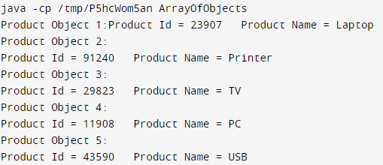
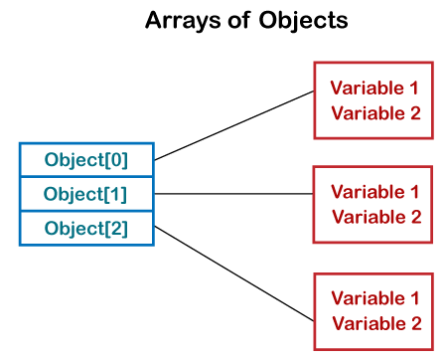
Array of Objects
public class ArrayOfObjects
{ public static void main(String args[])
{ Product[] obj = new Product[5] ;
obj[0] = new Product(23907,"Laptop");
obj[1] = new Product(91240,"Printer");
obj[2] = new Product(29823,"TV");
obj[3] = new Product(11908,"PC");
obj[4] = new Product(43590,"USB");
System.out.println("Product Object 1:"); obj[0].display();
System.out.println("Product Object 2:"); obj[1].display();
System.out.println("Product Object 3:"); obj[2].display();
System.out.println("Product Object 4:"); obj[3].display();
System.out.println("Product Object 5:"); obj[4].display();
} } class Product {
int pro_Id;
String pro_name;
Product(int pid, String n) {
pro_Id = pid;
pro_name = n; }
public void display()
{ System.out.print("Product Id = "+pro_Id + " " + " Product Name = "+pro_name);
System.out.println(); } }
Stores an array of objects
Array of Objects stores objects that mean objects are stored as elements of an array.
Array of Objects it is not the object itself that is stored in the array but the reference of the object.
Syntax : Class_Name[ ] objectArrayReference;
or
Class_Name objectArrayReference[ ];
Instantiate the array of objects –
Syntax:
Class_Name obj[ ]= new Class_Name[Array_Length];

Slide 57
Java-Static Keyword
class Student{
int rollno;//instance variable
String name;
static String college ="MIT";//static variable
//param. constructor
Student(int r, String n){
rollno = r;
name = n;
}
//method to display the values
void display (){System.out.println(rollno+" "+name+" "+college);}
}
public class TestStaticVariable{
public static void main(String args[]){
Student s1 = new Student(111,"ABC");
Student s2 = new Student(222,"PQR");
//we can change the college of all objects by the single line of code
//Student.college="CEG";
s1.display();
s2.display();
}
}
static keyword in Java is used for memory management mainly.
The static keyword belongs to the class than an instance of the class.
The static can be:
Variable (also known as a class variable)
Method (also known as a class method)
Block
Nested class
Java static variable
Declare any variable as static – static variable.
The static variable can be used to refer to the common property of all objects (which is not unique for each object)
for example: college/University name of students, etc.
The static variable gets memory only once in the class area at the time of class loading.
Advantages of static variable
It makes your program memory efficient (i.e., it saves memory).
static property is shared to all objects.

Slide 58


Java-Static Keyword
With static variable
public class Counter{
static int count=0;
Counter(){
count++;
System.out.println(count);
}
public static void main(String args[]){
Counter c1=new Counter();
Counter c2=new Counter();
Counter c3=new Counter();
}
}
Without static keyword
Instance variable named count which is incremented in the constructor.
Instance variable gets the memory at the time of object creation, each object will have the copy of the instance variable.
If it is incremented, it won't reflect other objects. So each object will have the value 1 in the count variable.
public class Counter{
int count=0;
Counter(){
count++;
System.out.println(count);
}
public static void main(String args[]){
Counter c1=new Counter();
Counter c2=new Counter();
Counter c3=new Counter();
}
}

Slide 59

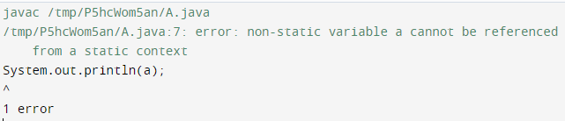

Java-Static Keyword
class Student{
int rollno;
String name;
static String college = "MIT";
//static method to change the value of static variable
static void change(){
college = "AU-MIT"; }
Student(int r, String n){
rollno = r;
name = n; }
void display(){System.out.println(rollno+" "+name+" "+college);} }
public class TestStaticMethod{
public static void main(String args[]){
Student.change(); (using class to access static method)
Student s1 = new Student(111,"ABC");
Student s2 = new Student(222,"PQR");
s1.display();
s2.display(); } }
public class Calculate{
static int cube(int x){
return x*x*x; }
public static void main(String args[]){
int result=Calculate.cube(5);
System.out.println(result);
}
}
Static method-apply static keyword with any method
A static method belongs to the class rather than the object of a class.
A static method can be invoked without the need for creating an instance of a class.
A static method can access static data member and can change the value of it.
A static method cannot be overridden.
Restrictions for the static method:
The static method can not use non static data member or call non-static method directly.
this and super cannot be used in static method.
public class A{
int a=40;//non static
public static void main(String args[]){
System.out.println(a);
} }
Java main method is static because object is not required to call a static method.
If it were a non-static method, JVM creates an object first then call main() method that will lead the problem of extra memory allocation.

Slide 60
A supermarket application needs to calculate the total bill by applying GST (Goods and Services Tax) or other common charges across all bills, but the tax rate is fixed and the logic doesn't depend on any specific customer's data.
class BillingUtil {
static double GST_RATE = 0.18; // 18% GST
// Static method to calculate final amount after tax
public static double calculateFinalAmount(double amount) {
return amount + (amount * GST_RATE);
}
}
public class Supermarket {
public static void main(String[] args) {
double bill1 = 1000;
double final1 = BillingUtil.calculateFinalAmount(bill1);
System.out.println("Final bill: ₹" + final1);
double bill2 = 500;
double final2 = BillingUtil.calculateFinalAmount(bill2);
System.out.println("Final bill: ₹" + final2);
}
}

Slide 61

Java-Static Keyword
Method Overloading-If a class has multiple methods having same name but different in parameters.
If we need to perform only one operation, having same name of the methods increases the readability of the program.
Eg. To perform addition of the given numbers but there can be any number of arguments.
Eg. a(int,int) for two parameters, and b(int,int,int) for three parameters then it may be difficult to understand the behavior of the method because its name differs.
Method Overloading is not possible by changing the return type of the method only.
Advantage of method overloading
Method overloading increases the readability of the program.
Different ways to overload the method
By changing number of arguments
By changing the data type
Static block
Is used to initialize the static data member.
It is executed before the main method at the time of classloading.
public class test{
static{System.out.println("static block is invoked");}
public static void main(String args[]){
System.out.println("Main method is invoked");
}
}
In new versions of JDK, it is not possible to execute a Java class without the main method.
public class test{
static{
System.out.println("static block is invoked");
System.exit(0);
}
}

Slide 62
Java-Method Overloading
Method Overloading- changing data type of arguments
Two methods that differs in data type.
The first add method receives two integer arguments and second add method receives two double arguments.
class Adder{
//static int add(int a, int b){return a+b;}
int add(int a, int b){return a+b;}
static double add(double a, double b)
{
return a+b;
}
}
public class TestOverloading2{
public static void main(String[] args){
Adder a = new Adder();
System.out.println(a.add(11,11));
//System.out.println(Adder.add(11,11));
System.out.println(Adder.add(12.3,12.6));
}}
Method Overloading: changing no. of arguments
Two methods, first add() method performs addition of two numbers and second add method performs addition of three numbers.
class Adder{
int add(int a,int b){return a+b;}
int add(int a,int b,int c){return a+b+c;}
}
public class TestOverloading1{
public static void main(String[] args){
Adder a= new Adder();
System.out.println(a.add(11,11));
System.out.println(a.add(11,11,11));
}}

Slide 63
Java-Method Overloading
Method Overloading- overload java main() method?
can have any number of main methods in a class by method overloading.
But JVM calls main() method which receives string array as arguments only.
public class TestOverloading {
public static void main(String[] args)
{
TestOverloading t=new TestOverloading();
t.main();
System.out.println("main with String[]");
}
public static void main(String args)
{
System.out.println("main with String");
}
/*public static void main()
{
System.out.println("main without args");
} */
public void main()
{
System.out.println("Test");}}
Method Overloading: It is not possible by changing the return type of the method only because of ambiguity.
class Adder{
static int add(int a,int b){return a+b;}
static double add(int a,int b){return a+b;}
}
public class TestOverloading{
public static void main(String[] args){
System.out.println(Adder.add(11,11));//ambiguity
}}

Slide 64
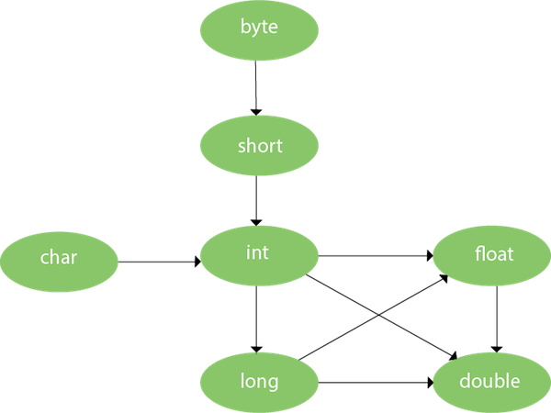
Java-Method Overloading-Type Promotion
One type is promoted to another implicitly if no matching datatype is found.
public class OverloadingCalculation{
void sum(int a,long b){System.out.println(a+b);}
void sum(int a,int b,int c){System.out.println(a+b+c);}
public static void main(String args[]){
OverloadingCalculation obj=new OverloadingCalculation();
obj.sum(20,20);//now second int literal will be promoted to long
obj.sum(20,20,20);
} }
Type Promotion if matching found
If there are matching type arguments in the method, type promotion is not performed.
public class OverloadingCalculation{
void sum(int a,int b){System.out.println("int arg method invoked");}
void sum(long a,long b){System.out.println("long arg method invoked");}
public static void main(String args[]){
OverloadingCalculation obj=new OverloadingCalculation();
obj.sum(20,20);//now int arg sum() method gets invoked
obj.sum(20L,40L);
}
}

Slide 65
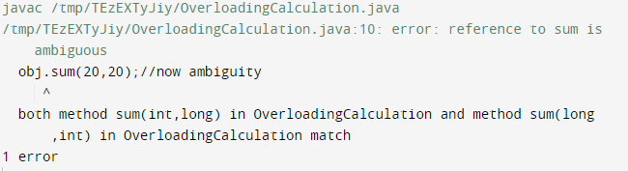
Java-Method Overloading-Type Promotion
Method Overloading with Type Promotion in case of ambiguity
If there are no matching type arguments in the method, and each method promotes similar number of arguments, there will be ambiguity.
One type is not de-promoted implicitly (eg., double cannot be depromoted to any type implicitly).
public class OverloadingCalculation{
void sum(int a,long b){System.out.println("a method invoked");}
void sum(long a,int b){System.out.println("b method invoked");}
public static void main(String args[]){
OverloadingCalculation obj=new OverloadingCalculation();
obj.sum(20,20);//now ambiguity
}
}

Slide 66
Java-String
By String literal : It is created by using double quotes. For Example: String s=“InformationTechnology";
Each time you create a string literal, the JVM checks the "string constant pool" first.
If the string already exists in the pool→ a reference to the pooled instance is returned.
If the string doesn't exist in the pool→ a new string instance is created and placed in the pool.
Advantage: To make Java more memory efficient (because no new objects are created if it exists already in the string constant pool).
By new keyword
String s=new String(“InformationTechnology");
JVM will create a new string object in normal (non-pool) heap memory
variable s will refer to the object in a heap (non-pool).
string is basically an object that represents sequence of char values. An array of characters works same as Java string.
char[] ch={‘w',‘e',‘b',‘t',‘e',‘c',‘h'};
String s=new String(ch);
Or
String s=‘webtech’; both cases are same
inbuilt methods to perform operations on strings: compare(), concat(), equals(), split(), length(), replace(), compareTo(), intern(), substring()
create strings in Java by using these three classes:
String-immutable, StringBuffer and StringBuilder-mutable
String objects are stored in a special memory area known as the "string constant pool".
Two ways to create String object:
By string literal
By new keyword

Slide 67
Java-String
String class methods:
char charAt(int index)-It returns char value for the particular index
int length()- returns string length
String substring(int beginIndex)-It returns substring for given begin index.
String substring(int beginIndex, int endIndex)- It returns substring for given begin index and end index.
boolean contains(CharSequence s)-It returns true or false after matching the sequence of char value.
static String join(CharSequence delimiter, CharSequence... elements)-It returns a joined string.
String concat(String str)-It concatenates the specified string.
String replace(char old, char new)-It replaces all occurrences of the specified char value.
String[] split(String regex)-It returns a split string matching regex.
int indexOf(int ch, int fromIndex)-It returns the specified char value index starting with given index.
String toLowerCase()-It returns a string in lowercase.
String toUpperCase()-It returns a string in uppercase.
static String valueOf(int value)-It converts given type into string. It is an overloaded method.
public class StringExample{
public static void main(String args[]){
String s1="java";
char ch[]={'w','e','l','c','o','m','e'};
String s2=new String(ch);
String s3=new String("example");
System.out.println(s1);
System.out.println(s2);
System.out.println(s3);
}}

Slide 68
Java-String
public class Testimmutablestring{
public static void main(String args[]){
String s="IPL";
s=s.concat(" 2021");
System.out.println(s);
}
}
s points to the “IPL 2021“, still IPL object is not modified.
Why immutable?
1. Security:
Strings are often used in file paths, URLs, Database credentials, Network sockets.
If a string were mutable, someone could change the value after its used causing serious security risks.
2. Thread safety
Since strings can’t change, they are inherently thread safe. Multiple threads can safely share the same string without synchronization.
String pooling for Memory efficiency
String s1=“hello”;
String S2= “hello”; Both refer to the same object in pool/
String objects are immutable(or) unmodifiable (or) unchangeable.
Once String object is created its data or state can't be changed but a new String object is created.
public class Testimmutablestring{
public static void main(String args[]){
String s="IPL";
s.concat(" 2021");//concat() method appends the string at the end
System.out.println(s);//will print IPL because strings are immutable objects
}
}
Here IPL is not changed but a new object is created with IPL 2021. (immutable String)
Two objects are created but s reference variable still refers to “IPL" not to “IPL 2021".
if we explicitly assign it to the reference variable, it will refer to “IPL 2021" object.

Slide 69
Java-StringBuffer Class
Methods:
append(String s)→It is used to append the specified string with this string.
insert(int offset, String s)→It is used to insert the specified string with this string at the specified position.
replace(int startIndex, int endIndex, String str)→It is used to replace the string from specified startIndex and endIndex.
reverse()→is used to reverse the string.
capacity()→It is used to return the current capacity.
charAt(int index)→It is used to return the character at the specified position.
length()→It is used to return the length of the string i.e. total number of characters.
StringBuffer class is used to create mutable (modifiable) String objects.
The StringBuffer class in Java is the same as String class except it is mutable.
Constructors:
StringBuffer()→It creates an empty String buffer with the initial capacity of 16.
StringBuffer(String str)→It creates a String buffer with the specified string..
StringBuffer(int capacity)→It creates an empty String buffer with the specified capacity as length.
public class StringBufferExample{
public static void main(String args[]){
StringBuffer sb=new StringBuffer("Hello ");
sb.append("Welcome back to dept");//now original string is changed
System.out.println(sb);
} }

Slide 70
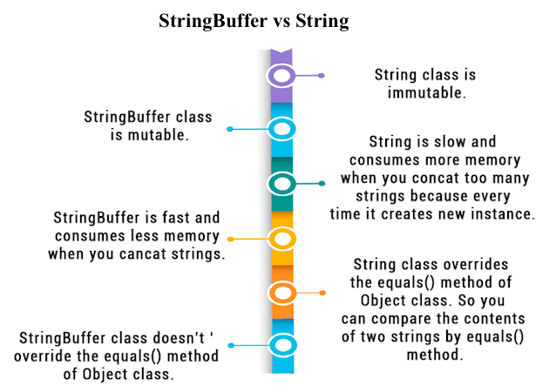
Java-StringBuilder Class
StringBuffer vs StringBuilder
StringBuilder class is used to create mutable (modifiable) String.
The Java StringBuilder class is same as StringBuffer class
Difference between StringBuffer and String
S.No | StringBuffer | StringBuilder
1) | StringBuffer is synchronized i.e. thread safe. It means two threads can't call the methods of StringBuffer simultaneously. | StringBuilder is non-synchronized i.e. not thread safe i.e suitable for single threaded environment. It means two threads can call the methods of StringBuilder simultaneously.
2) | StringBuffer is less efficient than StringBuilder. | StringBuilder is more efficient than StringBuffer.
3) | StringBuffer was introduced in Java 1.0 | StringBuilder was introduced in Java 1.5

Slide 71
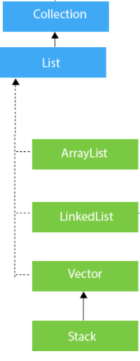
Java-Collections
Framework that provides an architecture to store and manipulate the group of objects.
Can achieve all the operations that you perform on a data such as searching, sorting, insertion, manipulation, and deletion.
Java Collection means a single unit of objects.
Java Collection framework provides many interfaces (Set, List, Queue, Deque)
classes (ArrayList, Vector, LinkedList, PriorityQueue, HashSet, LinkedHashSet, TreeSet)
Framework in Java
It provides readymade architecture.
It represents a set of classes and interfaces.
It is optional.
java.util package contains all the classes and interfaces for the Collection framework.
Few Methods in Collection:
boolean add(E e)
boolean addAll(Collection<? extends E> c)
boolean remove(Object element)
boolean removeAll(Collection<?> c)
int size()
void clear()
boolean contains(Object element)
Object[] toArray()
boolean isEmpty()
boolean equals(Object element)
Methods in Iterator:
Iterator interface provides the facility of iterating the elements in a forward direction only.
boolean hasNext()
Object next()
void remove()

Slide 72
Java-Collections
List Interface
child interface of Collection interface.
It inhibits a list type data structure in which we can store the ordered collection of objects.
It can have duplicate values.
List interface is implemented by the classes ArrayList, LinkedList, Vector, and Stack.
To instantiate the List interface, we must use :
List <data-type> list1= new ArrayList();
List <data-type> list2 = new LinkedList();
List <data-type> list3 = new Vector();
List <data-type> list4 = new Stack();
Methods in List interface that can be used to insert, delete, and access the elements from the list.
ArrayList
The ArrayList class implements the List interface.
It uses a dynamic array to store the duplicate element of different data types.
Maintains the insertion order and is non-synchronized.
The elements can be randomly accessed.
import java.util.*;
public class TestJavaCollection1{
public static void main(String args[]){
ArrayList<String> list=new ArrayList<String>();//Creating arraylist
list.add("Red");//Adding object in arraylist
list.add("Orange");
list.add("Red");
list.add("Green");
//Traversing list through Iterator
Iterator itr=list.iterator();
while(itr.hasNext()){
System.out.println(itr.next());
}
}
}

Slide 73
Java-Collections
Vector
Vector uses a dynamic array to store the data elements.
It is similar to ArrayList.
It is synchronized and contains many methods that are not the part of Collection framework.
Stack
The stack is the subclass of Vector.
It implements the last-in-first-out data structure.
The stack contains all of the methods of Vector class and also provides its methods like boolean push(), boolean peek(), boolean push(object o), which defines its properties.
peek() method in Java is used to retrieve or fetch the first element of the Stack or the element present at the top of the Stack.
import java.util.*;
public class TestJavaCollection{
public static void main(String args[]){
Stack<String> stack = new Stack<String>();
stack.push("Almond");
stack.push("Garlic");
stack.pop();
Iterator<String> itr=stack.iterator();
while(itr.hasNext()){
System.out.println(itr.next()); } } }
LinkedList
LinkedList implements the Collection interface.
Uses a doubly linked list internally to store the elements.
Can store the duplicate elements.
Maintains the insertion order and is not synchronized.
Manipulation is fast because no shifting is required.
import java.util.*;
public class TestJavaCollection2{
public static void main(String args[]){
LinkedList<String> al=new LinkedList<String>();
al.add("Ravi");
al.add("Vijay");
al.add("Ravi");
al.add("Ajay");
Iterator<String> itr=al.iterator();
while(itr.hasNext()){
System.out.println(itr.next());
} }
}

Slide 74
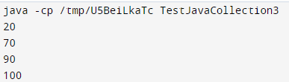
Java-Collections
import java.util.*;
public class TestJavaCollection3{
public static void main(String args[]){
Vector<Integer> v=new Vector<Integer>();
v.add(20);
v.add(70);
v.add(90);
v.add(100);
Iterator<Integer> itr=v.iterator();
while(itr.hasNext()){
System.out.println(itr.next());
}
}
}

Slide 75

Java-Collections-ArrayList
import java.util.*;
public class ArrayListExample {
public static void main(String[] args)
{
int n = 5;
ArrayList<Integer> arrli = new ArrayList<Integer>(n);
for (int i = 1; i <= n; i++)
arrli.add(i);
System.out.println(arrli);
// Remove element at index 3
arrli.remove(3);
System.out.println(arrli);
for (int i = 0; i < arrli.size(); i++)
System.out.print(arrli.get(i) + " ");
}
}
Java ArrayList class uses a dynamic array for storing the elements.
It is like an array, but there is no size limit.
We can add or remove elements anytime. So, it is much more flexible than the traditional array.
collection framework was non-generic before JDK 1.5. Since 1.5, it is generic.
old non-generic example of creating java collection.
ArrayList list=new ArrayList();//creating old non-generic arraylist
new generic example of creating java collection.
ArrayList<String> list=new ArrayList<String>();
In a generic collection, we specify the type in angular braces. Now ArrayList is forced to have the only specified type of objects in it, trying to add another type of object, it gives compile time error.

Slide 76
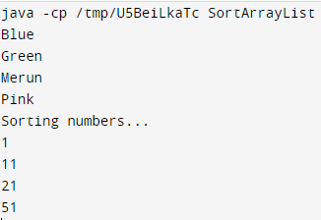
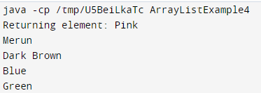
Java-Collections-ArrayList
Collections which has the static method sort().
Using the Collections.sort() method, sort can be performed in the ArrayList.
import java.util.*;
public class SortArrayList{
public static void main(String args[]){
List<String> list1=new ArrayList<String>();
list1.add("Merun");
list1.add("Pink");
list1.add("Blue");
list1.add("Green");
//Sorting the list
Collections.sort(list1);
for(String f:list1)
System.out.println(f);
System.out.println("Sorting numbers...");
//Creating a list of numbers
List<Integer> list2=new ArrayList<Integer>();
list2.add(21); list2.add(11);
list2.add(51); list2.add(1);
//Sorting the list
Collections.sort(list2);
for(Integer number:list2)
System.out.println(number);
} }
import java.util.*;
public class ArrayListExample4{
public static void main(String args[]){
ArrayList<String> al=new ArrayList<String>();
al.add("Merun");
al.add("Pink");
al.add("Blue");
al.add("Green");
//accessing the element
System.out.println("Returning element: "+al.get(1));
//changing the element
al.set(1,"Dark Brown");
//Traversing list
for(String t:al)
System.out.println(t);
} }

Slide 77
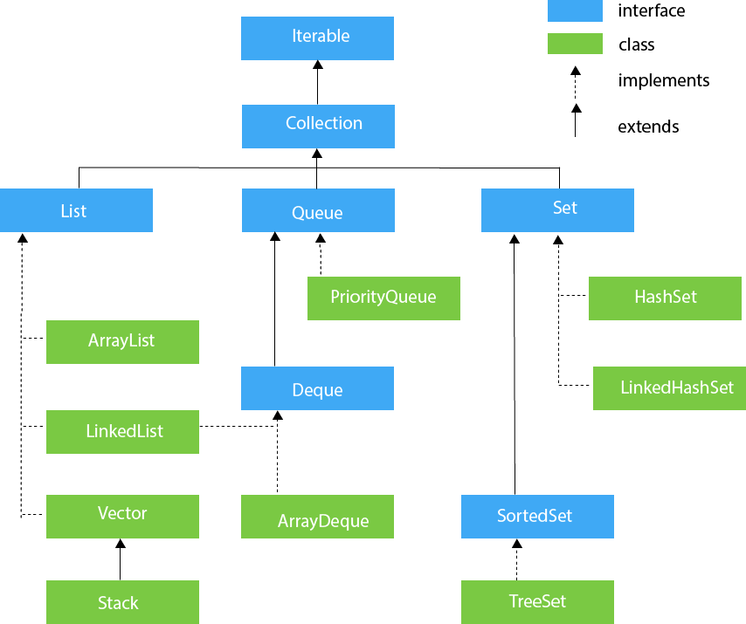
Java-Collections-Queue
Queue interface maintains the first-in-first-out order.
It can be defined as an ordered list that is used to hold the elements which are about to be processed.
There are various classes like PriorityQueue and ArrayDeque which implements the Queue interface.
Queue interface can be instantiated as:
Queue<String> q1 = new PriorityQueue();
Queue<String> q2 = new ArrayDeque();
PriorityQueue
The PriorityQueue class implements the Queue interface.
It holds the elements or objects which are to be processed by their priorities.
PriorityQueue doesn't allow null values to be stored in the queue.
Deque Interface
Deque interface extends the Queue interface. In Deque, we can remove and add the elements from both the side.
Deque stands for a double-ended queue which enables us to perform the operations at both the ends.
Deque can be instantiated as: Deque d = new ArrayDeque();

Slide 78
Java-Collections-Queue
ArrayDeque
ArrayDeque class implements the Deque interface.
It facilitates us to use the Deque.
Unlike queue, we can add or delete the elements from both the ends.
ArrayDeque is faster than ArrayList and Stack and has no capacity restrictions.
Set Interface
Set Interface in Java is present in java.util package.
It extends the Collection interface. It represents the unordered set of elements which doesn't allow us to store the duplicate items. We can store at most one null value in Set.
Set is implemented by HashSet, LinkedHashSet, and TreeSet.
Set<data-type> s1 = new HashSet<data-type>();
Set<data-type> s2 = new LinkedHashSet<data-type>();
Set<data-type> s3 = new TreeSet<data-type>();
HashSet
HashSet class implements Set Interface.
It represents the collection that uses a hash table for storage.
Hashing is used to store the elements in the HashSet. It contains unique items.
LinkedHashSet
LinkedHashSet class represents the LinkedList implementation of Set Interface.
It extends the HashSet class and implements Set interface.
Like HashSet, It also contains unique elements.
It maintains the insertion order and permits null elements.

Slide 79
Java-Collections-Queue
HashMap class implements the Map interface which allows us to store key and value pair, where keys should be unique.
If you try to insert the duplicate key, it will replace the element of the corresponding key.
It is easy to perform operations using the key index like updation, deletion, etc. HashMap class is found in the java.util package.
HashMap in Java is like the legacy Hashtable class, but it is not synchronized. It allows us to store the null elements as well, but there should be only one null key.
Since Java 5, it is denoted as HashMap<K,V>, where K stands for key and V for value. It inherits the AbstractMap class and implements the Map interface.
Hashtable class implements a hashtable, which maps keys to values.
It inherits Dictionary class and implements the Map interface.
A Hashtable is an array of a list. Each list is known as a bucket. The position of the bucket is identified by calling the hashcode() method.
A Hashtable contains values based on the key.
Java Hashtable class contains unique elements.
Java Hashtable class doesn't allow null key or value.
Java Hashtable class is synchronized.
The initial default capacity of Hashtable class is 11
SortedSet Interface
SortedSet is the alternate of Set interface that provides a total ordering on its elements.
The elements of the SortedSet are arranged in the increasing (ascending) order.
The SortedSet provides the additional methods that inhibit the natural ordering of the elements.
The SortedSet can be instantiated as:
SortedSet<data-type> set = new TreeSet();
TreeSet
Java TreeSet class implements the Set interface that uses a tree for storage.
Like HashSet, TreeSet also contains unique elements.
However, the access and retrieval time of TreeSet is quite fast.
The elements in TreeSet stored in ascending order.

Slide 80

Java-Collections-Queue
class CollectionDemo {
public static void main(String[] args)
{
int arr[] = new int[] { 1, 2, 3, 4 };
Vector<Integer> v = new Vector();
Hashtable<Integer, String> h = new Hashtable();
v.addElement(1);
v.addElement(2);
h.put(1, "IT dept");
h.put(2, "welcome");
System.out.println(arr[0]);
System.out.println(v.elementAt(0));
System.out.println(h.get(1));
}
}

